Slide 1
DISPOSABLE MEDICAL ITEMS
CONTACT : JR ENTERPRISE - AHMEDABAD
RAJESH JHA +91 9724022068

Slide 2
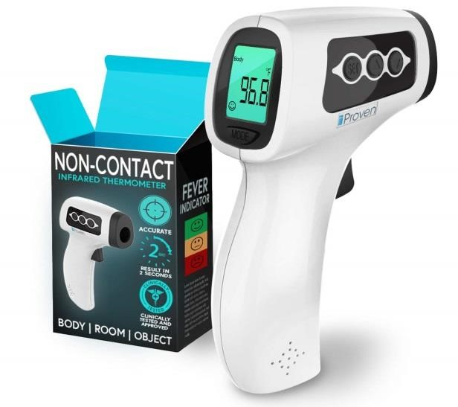
IR Thermometer
Measurement range：32.0 ~42.2
Permissible error： ±0.2 （35.0 ~42.0 ）
±0.3 （32.0 ~34.9 及42.1 ~42.2 ）
Memory function： 32 sets of memory queries
Power Source: AAA Size × 2 (DC 3V)
Dimensions (L×W×H) ：37mm*37mm*138mm
Approx. Weight (without batteries and cuff) ：About 47g
Auto power-off: Not used for about 1 minute
Packing: 120pcs per carton 47*41*41cm 10.4kgs/ctn box size 65*45*190mm
Lead time: 10-15 Days from confirm order
Minimum Order Quantity : - 1000 Pcs
Price per unit Rs- 5300 /- Ex Ahmedabad
Payment Terms: - 100% Advance to Confirm the order due to High Demand.
CONTACT : JR ENTERPRISE – AHMEDABAD : RAJESH JHA WhatsApp : +91 9724022068

Slide 3
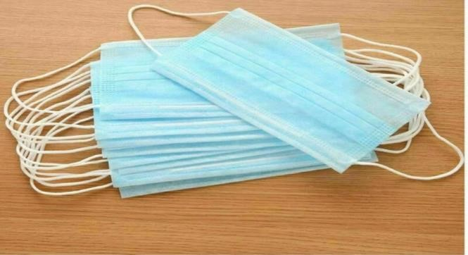
3 Ply Mask
Provide users with an excellent protective barrier.
Masks are made with 3-ply construction with melt blow Filter.
3 layers 0f 18-20 gsm each.
Providing bacterial filtration properties that exceed the minimum requirements of the European Type II standard.
Easily slide over the ear with a soft elastic rubber sting which holds the mask securely to the wearer.
Unit Size 100 Mask /pack
Date of expiry 3 years
Lead time: 3-5 Days from confirm order.
Minimum Order Quantity : - 2 lakh Pcs
Price per Pack Rs-: 800 /- Ex Ahmedabad
Payment terms: - 100% Advance due to High Demand
CONTACT : JR ENTERPRISE – AHMEDABAD : RAJESH JHA WhatsApp : +91 9724022068

Slide 4
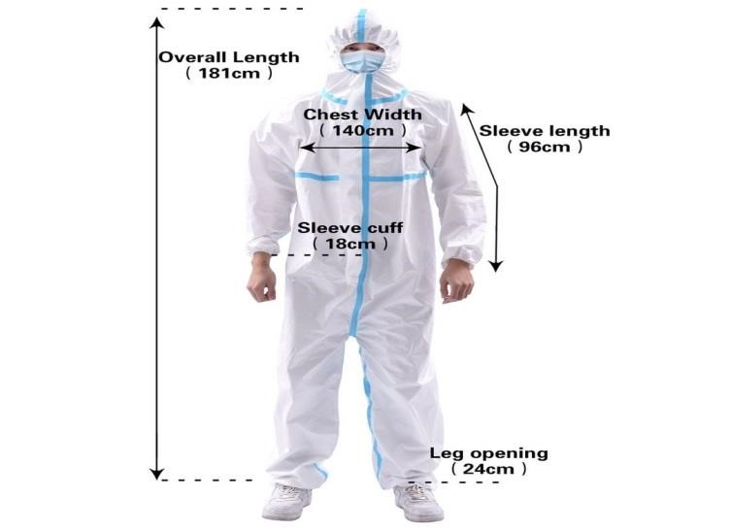
Personal Protection Kit (PP Kit)
Product Description : This complete Personal Protection Kit is packaged in a clear bag and can be stored in a one case. The kit contains all necessary components to insure officer protection in one convenient package. Based on the skills of our adroit professionals and creative workers, we bring forth an extensive range of Personal Protection Kit. Owing to features like fine finish, durability and easy installation, the offered products are extensively demanded in the market. A team of our adept professionals with hard-earned experience manufacture the offered range using high grade raw material and the latest technology.
Features: : Light weight ; Dimensional accuracy ; Compact ; Non-woven, 80 gsm
Kit Contents: : Coverall w/hood ; Pair of Anti-Skid Shoe/ Boot Covers ; Pair of Latex Gloves ; Protective Safety Goggles ; 3ply Mask ; Biohazard Disposal Bag
Lead time: 5 -7 Days from confirm order
Minimum Order Quantity: - 10,000 Pcs
Price per unit Rs-: 1000 /-
Payment terms: - 100% Advance due to High Demand
CONTACT : JR ENTERPRISE – AHMEDABAD : RAJESH JHA WhatsApp : +91 9724022068

Slide 5
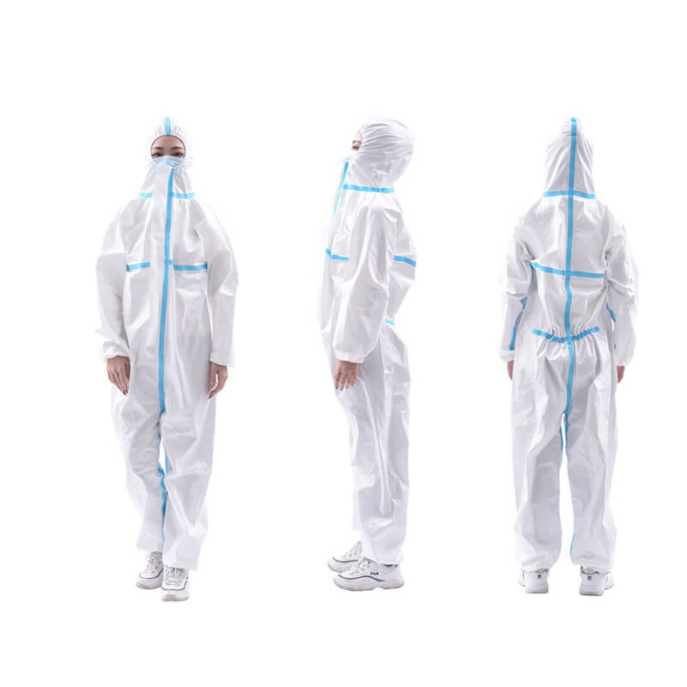
Body suit, Fluid-Resistant Gown
Product Description
Hooded Coverall Features:
Light weight
Dimensional accuracy
Compact
Non-woven, 80 gsm
Lead time: 2-3 Days from confirm order
Minimum Order Quantity : - 50,000 Pcs
Price per unit Rs-: 600/- Ex Ahmedabad.
Payment terms: - 100% Advance due to High Demand.
CONTACT : JR ENTERPRISE – AHMEDABAD : RAJESH JHA WhatsApp : +91 9724022068

Slide 6
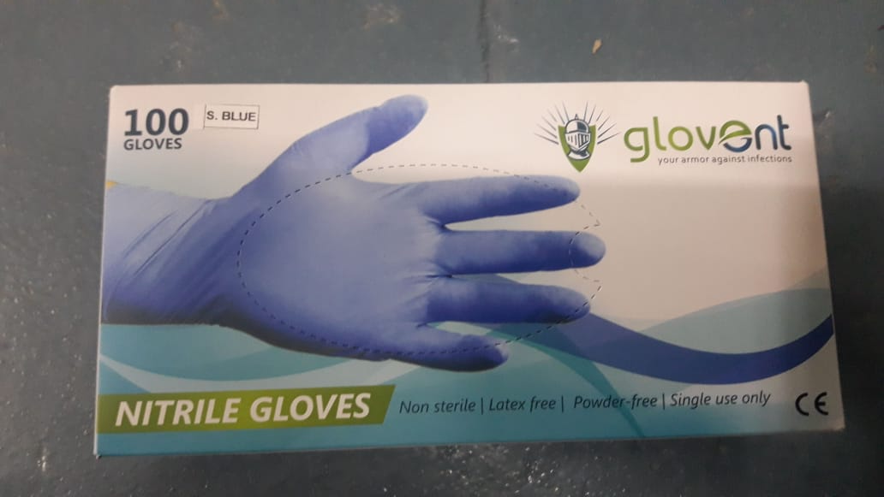
Medical use Inner and Outer Nitrile gloves:
Medical use Inner and Outer Nitrile gloves:
Ultra-Soft to minimize stress.
100% Latex Free.
Powder Free. Non-sterile.
Stronger. Meets/exceeds NFPA requirements.
Tested using medical level standard.
Light yellow color.
100/box, 10 boxes/case.
Lead time: 5-7 Days from confirm order
Minimum Order Quantity: - 2,00,000 Pcs
Price per pcs : Rs 12 /-
Payment terms: - 100% Advance due to High Demand
CONTACT : JR ENTERPRISE – AHMEDABAD : RAJESH JHA WhatsApp : +91 9724022068

Slide 7
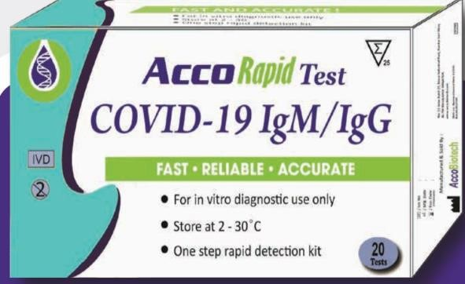
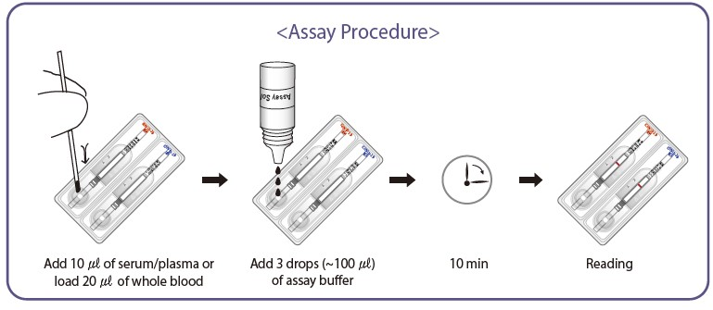
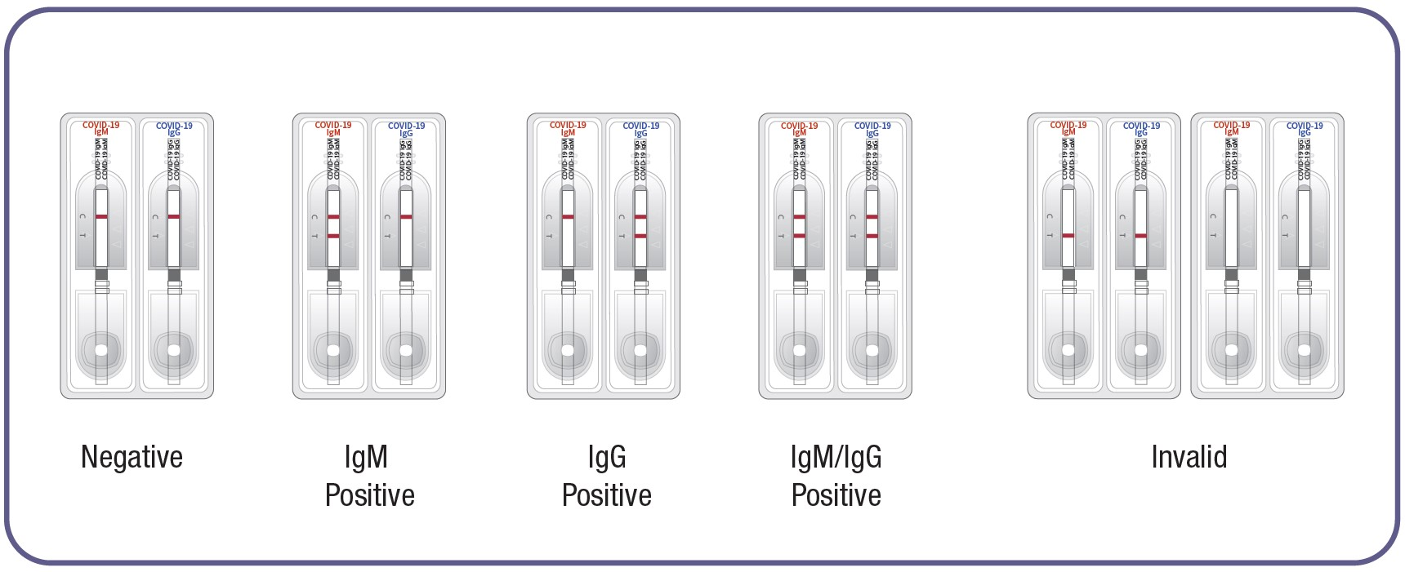
Acco COVID-19 IgM/IgG Rapid Test Kit
Intended use : Acco COVID-19 IgM/IgG device is a chromatographic immunoassay kit for the rapid and differential detection of immunoglobulin M (lgM) and immunoglobulin G (IgG) against COVID-19 using serum, plasma and whole blood.
Specifications for this item
Brand Name : Acco COVID-19 IgM/IgG
Unit Size 20 pcs/pack
Storage and expiration
Acco COVID-19 IgM/IgG should be stored between 2 to 30°C (35.6 to 86°F).
Expiration date of this kit is 24 months after its manufacture date.
Lead time: 3-5 Days from confirm order
Minimum Order Quantity: 10,000 Kits
Price per Pack Rs-: 30,000 INR/-
Payment terms: - 100% Advance Due to High Demand
CONTACT : JR ENTERPRISE – AHMEDABAD : RAJESH JHA WhatsApp : +91 9724022068

Slide 8
Self Use COVID 19 PRE-SCREENING KIT
No lab visits, no doctors
Just one finger prick of blood
Very Cost Effective Solution
Benefits of pre-screening
Exponentially faster
No Queues, No Wait time for results
Exponentially more cost effective
Early Detection & Elimination
Effort less, and accessible to everyone nationwide, instantly
Viable precautionary step
Lead time: 15 Days from confirm order
Minimum Order Quantity : 30,000 Kits
Price Per Kit Unit Rs-: 850/-
Payment Terms: - 100% Advance Due to High Demand
European CE certified
ICMR Certified
National Institute Of Virology - India
CONTACT : JR ENTERPRISE – AHMEDABAD : RAJESH JHA WhatsApp : +91 9724022068

Slide 9


Other Products of Regular Use
Lead time: 5 to 15 Days from confirm order
Product | Price Per Unit | Minimum Order Quantity
N95 Masks | ₹ 125 | 30,000
3 Ply Mask | ₹ 8 | 2,00,000
PPE Kit | ₹ 1,000 | 50,000
Gloves | ₹ 12 | 2,00,000
Rapid Testing Kit | ₹ 850 | 30,000
IR THERMOMETER | ₹ 5,300 | 1,000
Visor | ₹ 80 | 10,000
Goggles | ₹ 120 | 10,000
CONTACT :
RAJESH JHA
JR ENTERPRISE – AHMEDABAD
WhatsApp : +91 972 402 2068
Payment terms: - 100% Advance Due to High Demand

